Slide 1


<Name>
<Date>

Slide 2
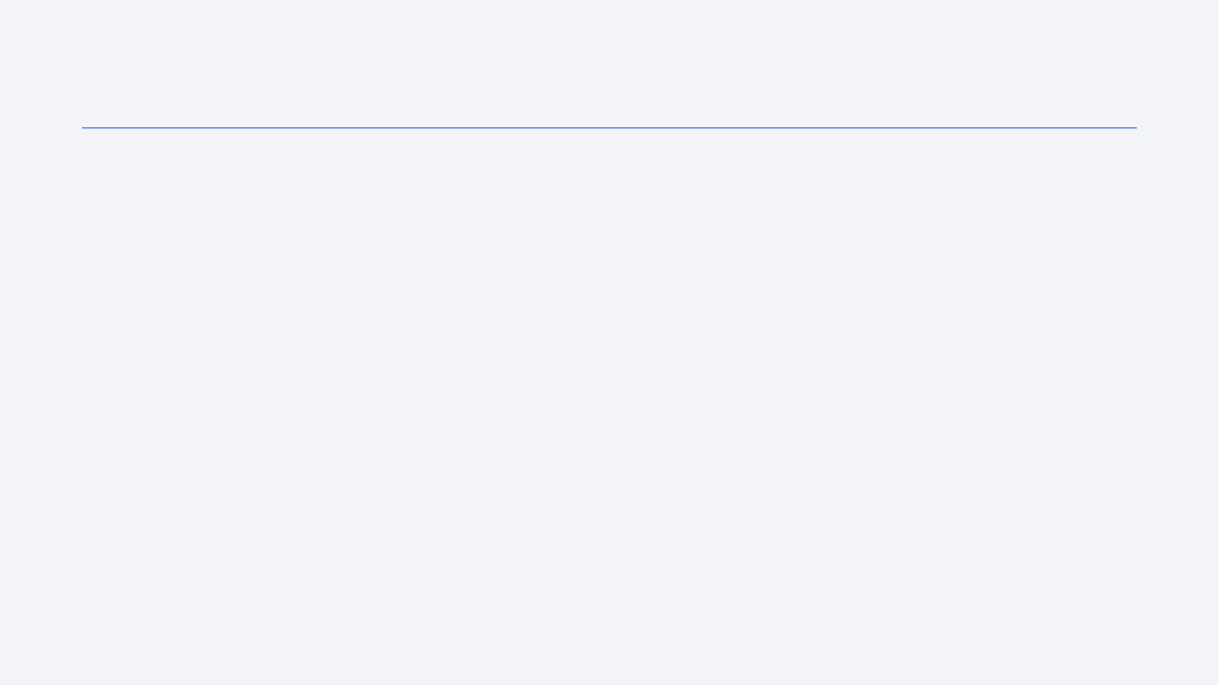
Outline
Executive Summary
Introduction
Methodology
Results
Conclusion
Appendix

Slide 3
Executive Summary
Summary of methodologies
Data Collection through API
Data Collection with Web Scraping
Data Wrangling
Exploratory Data Analysis with SQL
Exploratory Data Analysis with Data Visualization
Interactive Visual Analytics with Folium
Machine Learning Prediction
Summary of all results
Exploratory Data Analysis result
Interactive analytics in screenshots
Predictive Analytics result

Slide 4
Introduction
Project background and context
SpaceX has revolutionized the space launch industry by offering Falcon 9 launches at $62 million per mission, significantly undercutting competitors who charge upwards of $165 million. This cost advantage stems primarily from SpaceX's ability to recover and reuse the first stage of their rockets. Understanding whether a first stage will land successfully is therefore crucial for estimating launch costs, particularly valuable for companies considering competitive bids against SpaceX. Our project aims to develop a machine learning pipeline to predict first stage landing success.
Problems you want to find answers
Identify and analyze the key factors that influence successful rocket landings
Understand the relationships and interactions between different variables that affect landing success rates
Determine the optimal operating conditions required to maximize the probability of successful landings

Slide 5

Section 1

Slide 6
Methodology
Executive Summary
Data collection methodology:
Describe how data was collected
Perform data wrangling
Describe how data was processed
Perform exploratory data analysis (EDA) using visualization and SQL
Perform interactive visual analytics using Folium and Plotly Dash
Perform predictive analysis using classification models
How to build, tune, evaluate classification models

Slide 7
Data Collection Process
Key Steps:
API Data: Sent GET requests to SpaceX API, decoded JSON response, and converted to pandas dataframe using .json_normalize().
Data Cleaning: Handled missing values and inconsistencies.
Web Scraping: Scraped Falcon 9 launch records from Wikipedia using BeautifulSoup, parsed HTML tables, and converted to pandas dataframe.
Integration: Combined API and scraped datasets for analysis.
[GET Request → SpaceX API]
[Decode JSON → Pandas Dataframe]
[Clean Data]
[Scrape Wikipedia → Parse HTML Table → Pandas Dataframe]
[Combine Datasets]

Slide 8
Data Collection – SpaceX API
Request API and Parse SpaceX Launch Data
Send a GET request to the SpaceX API.
Filter Data for Falcon 9 Launches
Extract and filter the dataset to include only Falcon 9 launches.
Handle Missing Values
Identify and address missing or incomplete data points in the filtered dataset.
Parse and load the retrieved launch data into a structured format.
Apply appropriate methods (e.g., imputation, removal) to ensure data quality.
SpaceX provides a public API that allows data retrieval and utilization.
The API was accessed following the outlined flowchart, and the retrieved data was then stored.
📌 The source code is available on GitHub [here]

Slide 9
Data Collection - Scraping
Send a request to the Falcon 9 Launch Wikipedia page.
Extract column/variable names from the HTML table headers.
Parse the launch data tables and create a structured DataFrame.
SpaceX launch data can also be retrieved from Wikipedia.
The data is downloaded following the outlined flowchart and then stored.
📌 The source code is available on GitHub [here]

Slide 10
Data Wrangling
Send a request to the Falcon 9 Launch Wikipedia page.
Extract column/variable names from the HTML table headers.
Parse the launch data tables and create a structured DataFrame.
An initial Exploratory Data Analysis (EDA) was conducted on the dataset.
Summaries were generated for launches per site, orbit occurrences, and mission outcomes per orbit type.
Lastly, the landing outcome label was derived from the Outcome column.
📌 The source code is available on GitHub [here]

Slide 11
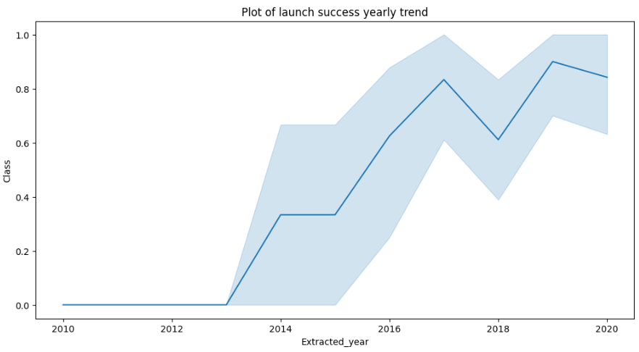
EDA with Data Visualization
The EDA with data visualization explored relationships between key launch factors.
Flight Number vs. Launch Site
Payload Mass vs. Launch Site
Success Rate vs. Orbit Type
Flight Number vs. Orbit Type
Payload Mass vs. Orbit Type
Yearly Success Trend
📌 The source code is available on GitHub [here]

Slide 12
EDA with SQL
The following SQL queries were executed:
Display the unique launch sites in the space mission.
Show 5 records where launch sites start with the string 'CCA’.
Calculate the total payload mass carried by boosters launched by NASA (CRS).
Find the average payload mass carried by booster version F9 v1.1.
List the date of the first successful landing outcome on the ground pad.
List the names of boosters that succeeded in drone ships with payload masses between 4000 and 6000.
Count the total number of successful and failed mission outcomes.
Identify booster versions that carried the maximum payload mass using a subquery.
Retrieve records showing the month names, failed landing outcomes on drone ships, booster versions, and launch sites for the months in 2015.
Rank landing outcomes (e.g., Failure on drone ship or Success on ground pad) between 2010-06-04 and 2017-03-20 in descending order.
📌 The source code is available on GitHub [here]

Slide 13
Build an Interactive Map with Folium
Markers: Markers are used to indicate specific points on the map, such as launch sites or important locations. They help users easily identify key spots.
Circles: Circles are used to highlight specific areas, such as around a particular launch site, making it visually clear where a certain event or region is located.
Lines: Lines can be used to indicate distances or paths between two points, such as the route from one launch site to another, or the distance between launch locations and key landmarks.
Marker Clusters: These group multiple markers that are located close to each other, making the map cleaner and more organized. This is particularly helpful in cases like launches in multiple sites where markers could overlap.
📌 The source code is available on GitHub [here]

Slide 14
Build a Dashboard with Plotly Dash
The dashboard includes:
Success Pie Chart: Percentage of successful launches by site.
Payload-Outcome Scatter Plot: Correlation between payload range and launch success.
Dropdown & Slider: Filter by site and payload.
These visualizations help analyze payload distribution across launch sites and determine the best site for different payloads. These visualizations help analyze payload distribution across launch sites and determine the best site for different payloads.
📌 The source code is available on GitHub [here]

Slide 15
Predictive Analysis (Classification)
Four classification models were evaluated: logistic regression, support vector machine, decision tree, and k-nearest neighbors.
📌 The source code is available on GitHub [here]
Data preparation and standardization
Testing of each model with various hyperparameter combinations Comparison of results
Comparison of results

Slide 16
Results
Exploratory data analysis results
SpaceX operates from four distinct launch sites, with the majority of launches occurring at East Coast locations.
The first launches were conducted for SpaceX and NASA.
The average payload capacity of the Falcon 9 v1.1 booster is 2,928 kg.
The first successful landing occurred in 2015, five years after the initial launch.
Several versions of the Falcon 9 booster successfully landed on drone ships with payloads exceeding the average.
Nearly 100% of mission outcomes were successful.
In 2015, two Falcon 9 v1.1 booster versions, B1012 and B1015, failed to land on drone ships.
Landing success improved over the years.
Interactive analytics revealed that launch sites are typically located in safe areas, often near the sea, and are supported by strong logistical infrastructure.

Slide 17
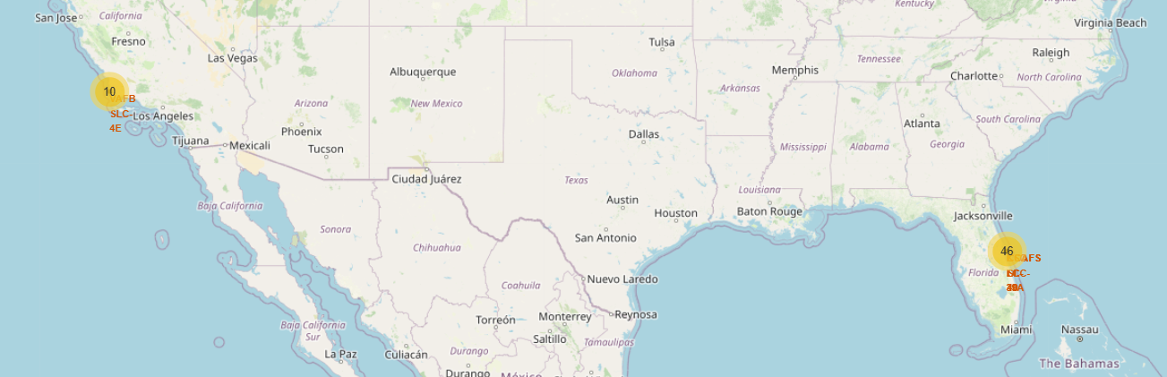
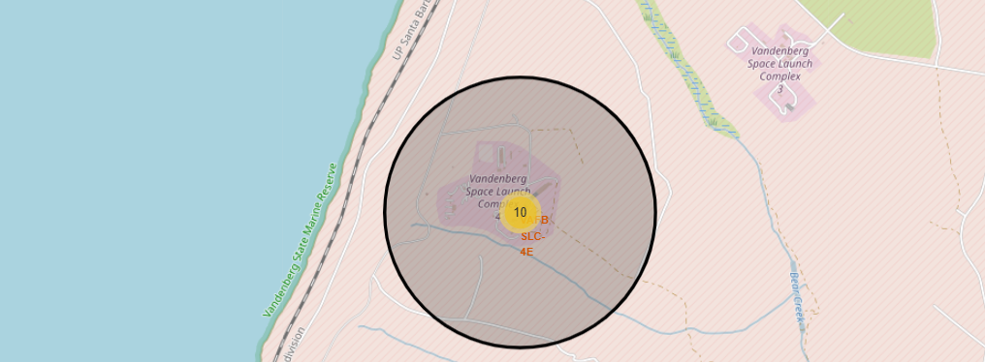
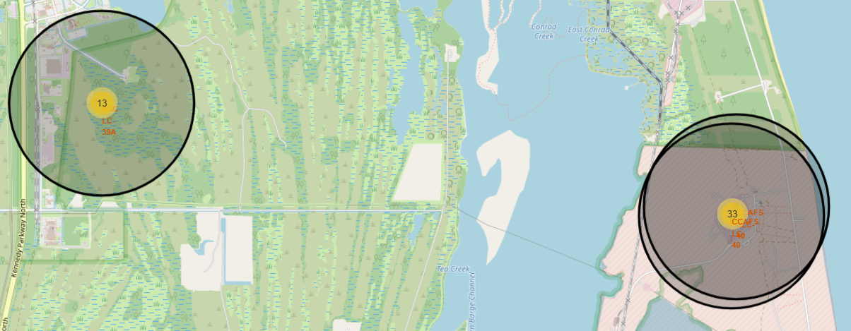
Results

Slide 18
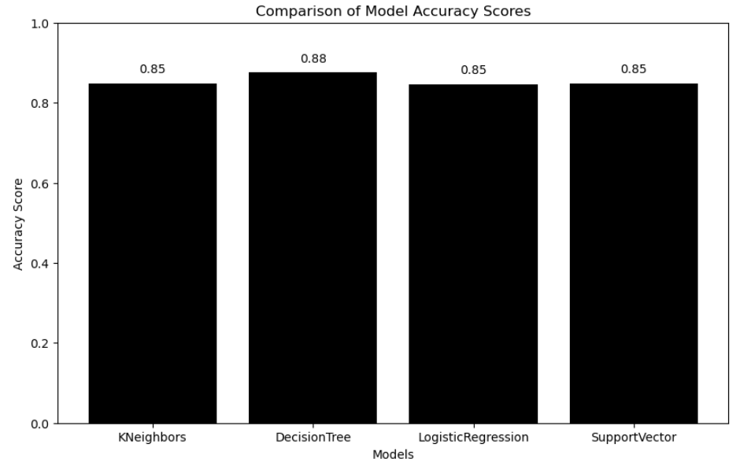
Results
Predictive analysis revealed that the Decision Tree Classifier is the top-performing model for predicting successful landings, with an accuracy of 88%, outperforming other models such as KNeighbors, Logistic Regression, and Support Vector (all at 85%)

Slide 19

Section 2

Slide 20
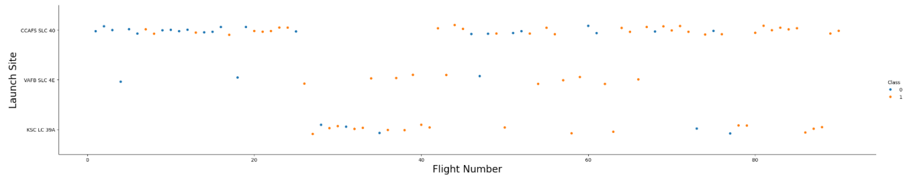
Flight Number vs. Launch Site
- The plot confirms that the best launch site currently is CCAF5 SLC 40, where most recent launches have been successful.
- In second place is VAFB SLC 4E, followed by KSC LC 39A in third.
- Additionally, the plot shows that the overall success rate has improved over time.

Slide 21
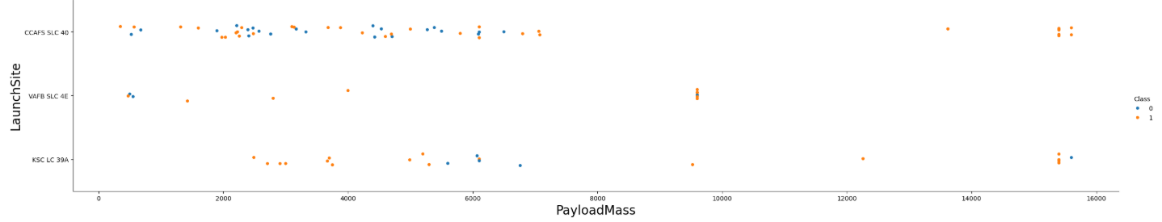
Payload vs. Launch Site
Payloads exceeding 9,000kg (roughly the weight of a school bus) demonstrate a high success rate.
Payloads above 12,000kg appear to be feasible only at the CCAFS SLC 40 and KSC LC 39A launch sites.

Slide 22
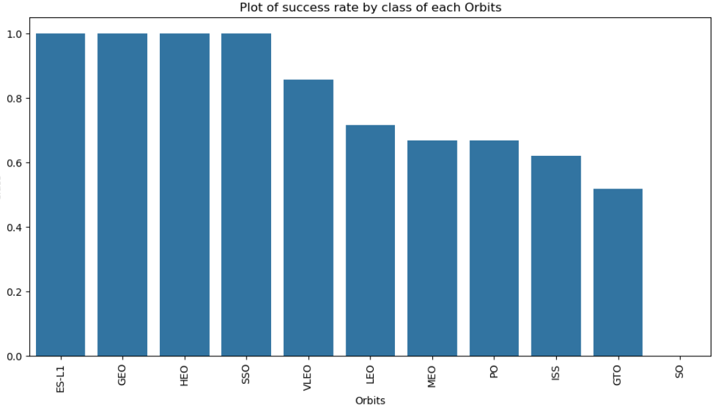
Success Rate vs. Orbit Type
The highest success rates occur for the following orbits:
ES-L1
GEO
HEO
SSO
Next in line are:
VLEO (above 80%)
LFO (above 70%)

Slide 23
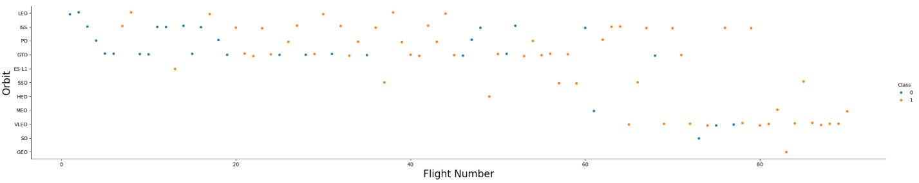
Flight Number vs. Orbit Type
It appears that the success rate has improved over time across all orbits.
The VLEO orbit seems to present a new business opportunity, driven by its recent increase in frequency.

Slide 24
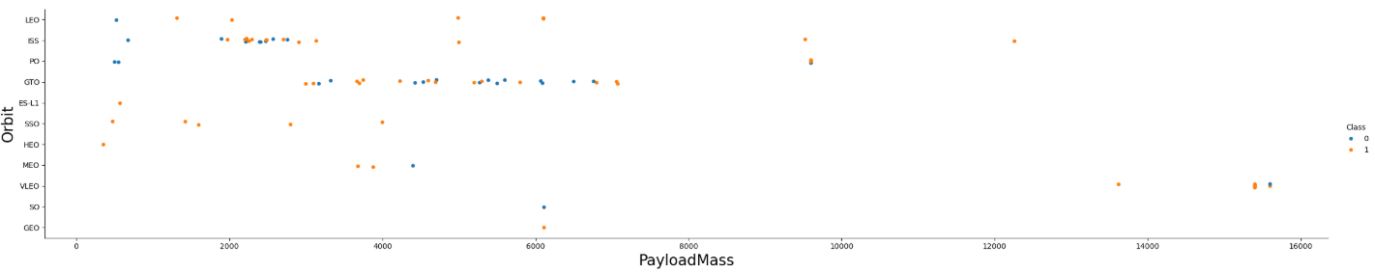
Payload vs. Orbit Type
It seems there is no correlation between payload and success rate for the GTO orbit.
The ISS orbit offers the widest range of payloads and a high success rate.
There have been few launches to the SO and GEO orbits.

Slide 25
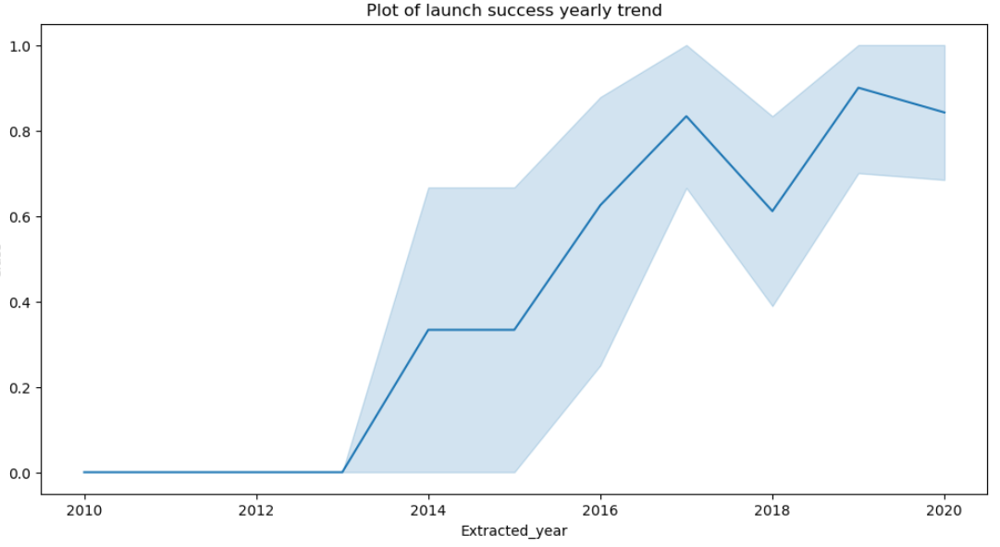
Launch Success Yearly Trend
The success rate began increasing in 2013 and continued to rise until 2020.
It appears that the first three years were a period of adjustment and technological improvement.

Slide 26
All Launch Site Names
According to the data, there are four launch sites.
These are identified by selecting unique occurrences of the "launch_site" values from the dataset.
Launch Site
CCAFS LC-40
VAFB SLC-4E
KSC LC-39A
CCAFS SLC-40

Slide 27
Launch Site Names Begin with 'CCA'
Find 5 records where launch sites begin with `CCA`
Date | Time (UTC) | Booster Version | Launch Site | Payload | PAYLOAD MASS (KG) | Orbit | Customer | Mission Outcome | Landing Outcome
2010-06-04 | 18:45:00 | F9 v1.0 B0003 | CCAFS LC-40 | Dragon Spacecraft Qualification Unit | 0 | LEO | SpaceX | Success | Failure (parachute)
2010-12-08 | 15:43:00 | F9 v1.0 B0004 | CCAFS LC-40 | Dragon demo flight C1, two CubeSats, barrel of Brouere cheese | 0 | LEO (ISS) | NASA (COTS) NRO | Success | Failure (parachute)
2012-05-22 | 7:44:00 | F9 v1.0 B0005 | CCAFS LC-40 | Dragon demo flight C2 | 525 | LEO (ISS) | NASA (COTS) | Success | No attempt
2012-10-08 | 0:35:00 | F9 v1.0 B0006 | CCAFS LC-40 | SpaceX CRS-1 | 500 | LEO (ISS) | NASA (CRS) | Success | No attempt
2013-03-01 | 15:10:00 | F9 v1.0 B0007 | CCAFS LC-40 | SpaceX CRS-2 | 677 | LEO (ISS) | NASA (CRS) | Success | No attempt

Slide 28
Total Payload Mass
Total payload carried by boosters from NASA
The total payload was calculated by summing all payloads with codes containing "CRS," which corresponds to NASA.
Total Payload Mass
45596

Slide 29
Average Payload Mass by F9 v1.1
Average payload mass carried by booster version F9 v1.1
By filtering the data by the booster version and calculating the average payload mass, we obtained a value of 2,928 kg.
Avg Payload Mass
2928.4

Slide 30
First Successful Ground Landing Date
Find the dates of the first successful landing outcome on ground pad
By filtering the data by a successful landing outcome on the ground pad and selecting the minimum date, we can identify the first occurrence, which took place on 2015/12/22.
First Successful landing date
2015-12-22

Slide 31
Successful Drone Ship Landing with Payload between 4000 and 6000
List the names of boosters which have successfully landed on drone ship and had payload mass greater than 4000 but less than 6000
By selecting distinct booster versions based on the filters above, the result consists of these 4 versions.
Booster Version
F9 FT B1022
F9 FT B1026
F9 FT B1021.2
F9 FT B1031.2

Slide 32
Total Number of Successful and Failure Mission Outcomes
The number of successful and failed mission outcomes can be determined by counting occurrences of each outcome in the dataset.
By categorizing mission outcomes and tallying the records for each group, we derived the summary above.
Mission Outcome | Occurrences
Success | 100
Failure | 1

Slide 33
Boosters Carried Maximum Payload
Boosters that have carried the maximum payload mass, with a payload mass of 15,600 kg for all of them.
Booster Version
F9 B5 B1048.4
F9 B5 B1048.5
F9 B5 B1049.4
F9 B5 B1049.5
F9 B5 B1049.7
F9 B5 B1051.3
F9 B5 B1051.4
F9 B5 B1051.6
F9 B5 B1056.4
F9 B5 B1058.3
F9 B5 B1060.2
F9 B5 B1060.3

Slide 34
2015 Launch Records
List the failed landing outcomes in drone ship, their booster versions, and launch site names for in year 2015
Booster Version | Launch Site
F9 v1.1 B1012 | CCAFS LC-40
F9 v1.1 B1015 | CCAFS LC-40

Slide 35
Rank Landing Outcomes Between 2010-06-04 and 2017-03-20
Rank the count of landing outcomes (such as Failure (drone ship) or Success (ground pad)) between the date 2010-06-04 and 2017-03-20, in descending order
This data perspective highlights that "No attempt" must be considered.
Landing Outcome | Occurrences
No attempt | 10
Success (drone ship) | 5
Failure (drone ship) | 5
Success (ground pad) | 3
Controlled (ocean) | 3
Uncontrolled (ocean) | 2
Failure (parachute) | 2
Precluded (drone ship) | 1

Slide 36

Section 3

Slide 37
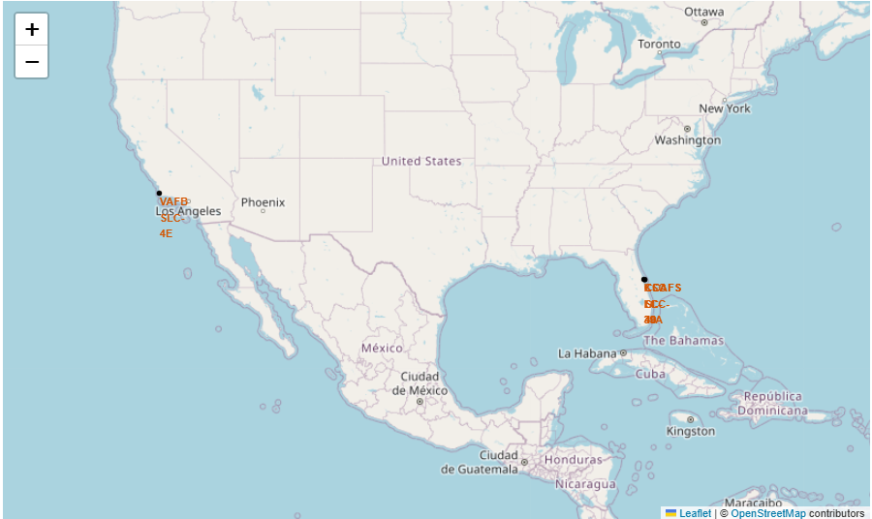
All launch sites
Launch sites are located near the sea, likely for safety reasons, while still being relatively close to roads and railroads.

Slide 38
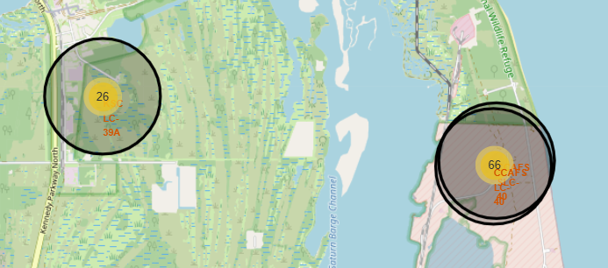
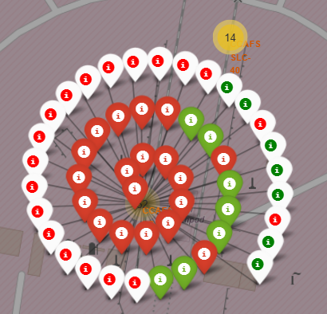
Launch outcomes categorized by site.
Example of launch outcomes from the CCAFS SLC-40 launch site.
Green= Successful Launch
Red= Failed Launch

Slide 39
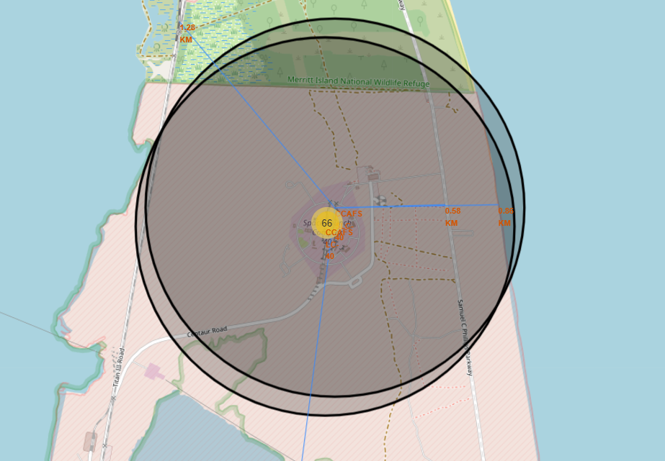
Distance to Launch Site
The obtained results show that all launch sites are located at a safe distance from railway lines and cities.

Slide 40

Section 4

Slide 41
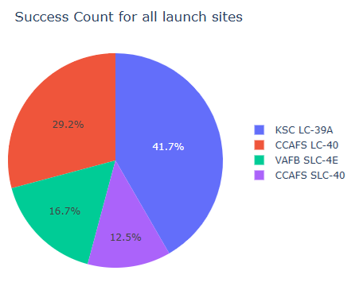
Success Rates of Rocket Launches Across Different Launch Sites
The highest success rates for launches were recorded at:
KSC LC-39A with a 41.7% success rate.
CCAFS LC-40 with a 29.2% success rate.

Slide 42
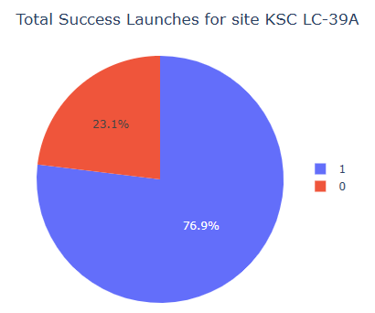
Total Success Launches for site KSC LC-39A
Site KSC LC-39 success rate is 76.9%

Slide 43
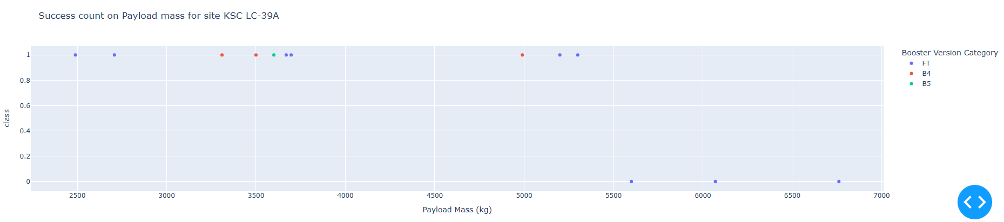
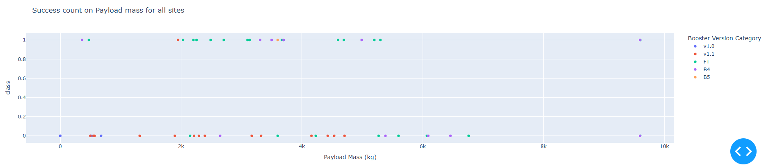
Payload vs. Launch Outcome Scatter Plot

Slide 44

Section 5

Slide 45
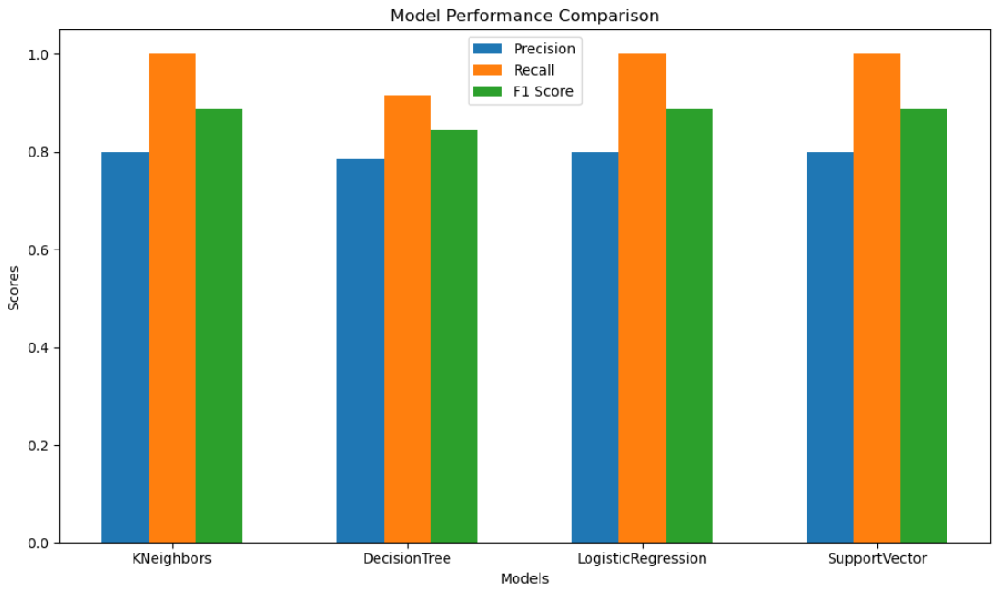
Classification Accuracy
KNeighbors, LogisticRegression, and SupportVector all have high precision (0.80), perfect recall (1.00), and an F1 score of 0.89. DecisionTree has slightly lower precision (0.79) and an F1 score of 0.85. Despite this, it achieved the highest score during cross-validation, with its optimal parameters contributing to its best performance.

Slide 46
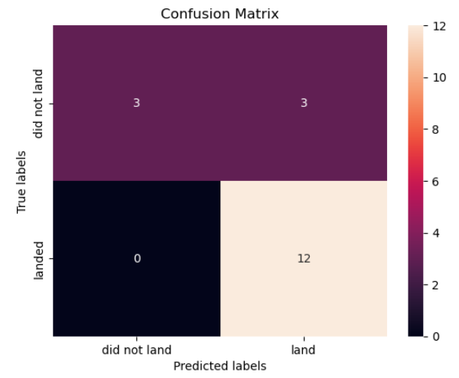
Confusion Matrix
The confusion matrix for the decision tree classifier reveals that the model is capable of distinguishing between the various classes. However, the primary issue lies in the occurrence of false positives, where unsuccessful landings are incorrectly classified as successful by the model.

Slide 47
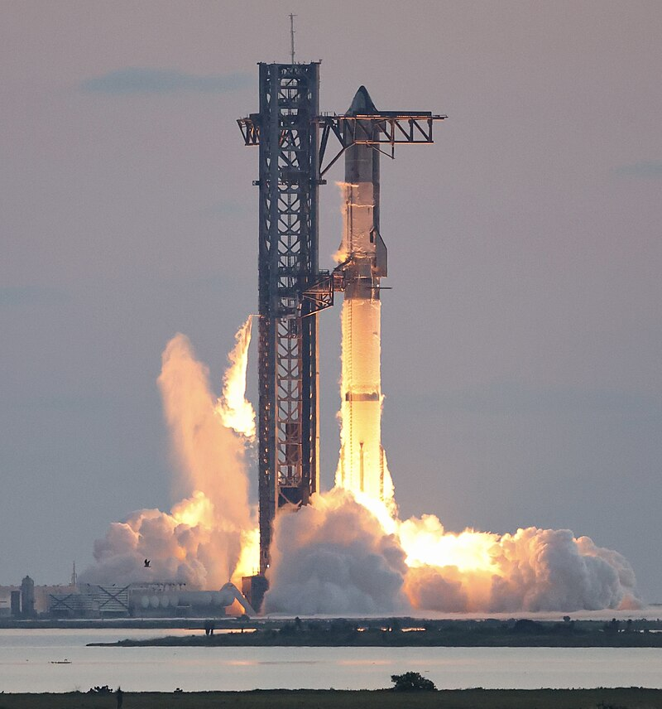
Conclusions
Based on the analysis, we can draw the following conclusions:
Launch sites with a higher number of flights tend to exhibit a greater success rate.
The launch success rate showed a consistent upward trend from 2013 through 2020.
Orbits such as ES-L1, GEO, HEO, SSO, and VLEO demonstrated the highest success rates.
Among all launch sites, KSC LC-39A recorded the highest number of successful launches.
The decision tree classifier outperformed other machine learning algorithms for this specific task.

Slide 48
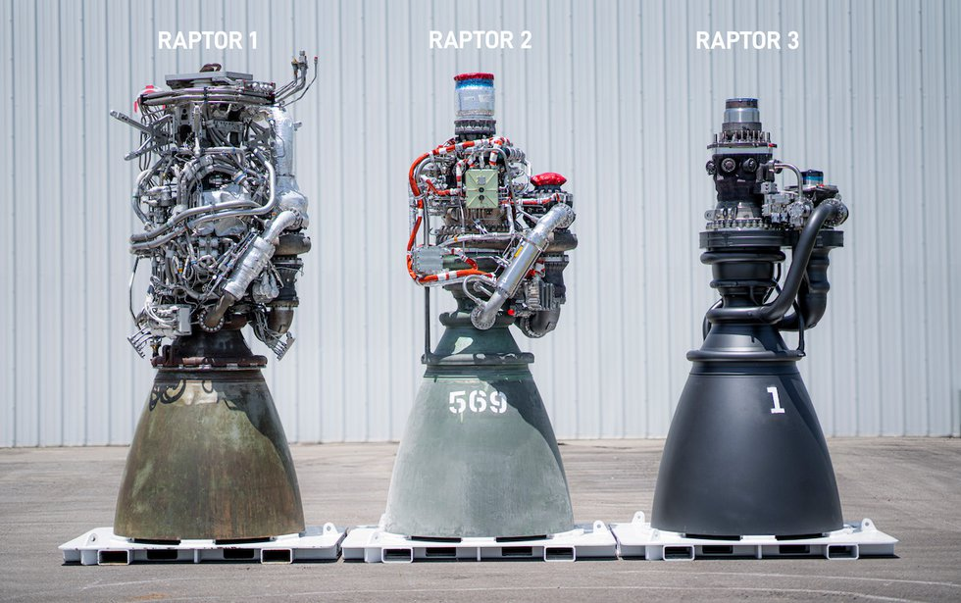
Appendix
📂 **GitHub**

Slide 49


